Slide 1
Welcome to
Back To School
Please find your child’s seat. We will begin at 6:00 and 6:30
Mrs. Hewitson
3rd Grade
Room E10

Slide 2
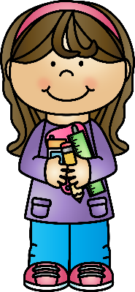
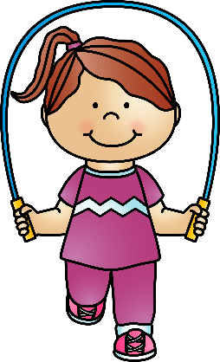
I believe that the parent-child-teacher connection is integral to success in school. I am here to support you and your child and will always be their advocate. I hope you let me know if you have any concerns about home or school life. Your child’s happiness and overall wellbeing are priorities to me during their time in third grade. I want them to feel safe and loved within the walls of our room and in our school!

Slide 3
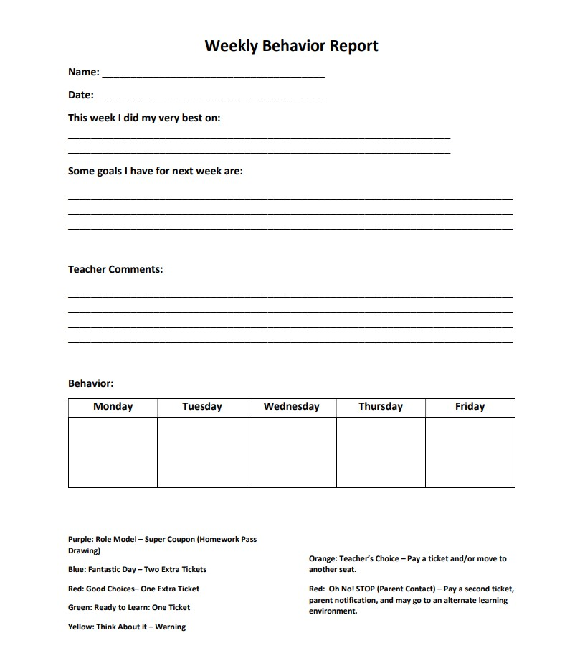
We use a daily class clip chart to monitor behavior. Students start on green every morning. Each day your child will come home with a color on their planner. Please keep a look out for this. If they moved their clip down, there will sometimes be a note from me to explain the reason. Please initial to show me that you have seen it. Daily charts will go home everyday. Please sign them over the weekend, and have your child bring them in on Mondays. Students will not receive their ticket for the day, if they do not have their signed behavior chart.
Students will have a chart, similar to this one, at their desk. They will monitor their behavior throughout the day. Please refer to the Classroom Management Agreement for specific colors and what they mean.
*Please consider signing up for our monthly treasure box. This will help me keep our box stocked and students interested in earning tickets.

Slide 4
Please make sure that you have established a pick-up location, and that your child is aware of what to do after school. Most parents use the grass/gate area or the loops as a pick-up location. If you are dropping off in the loop, please remember to pull forward, so that we can keep the traffic flowing.

Slide 5
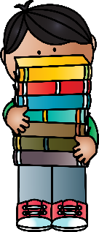
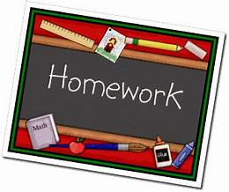
Homework consists of math and reading.
Math:
*One Go Math page per night. Students will have time to work on it in class and will take home what they don’t get finished. We will review this page the following morning. Students may incorporate IReady for extra math practice.
*Reading: 15-20 minutes each night. Students may use IReady for the reading practice. A reading log will be sent home. I will check it every Friday. However, reading logs will be collected each month. They should stay in their binder.
*Daily Multiplication Practice: In a few weeks, we will begin working on a weekly multiplication brochure that will be due on Friday.

Slide 6
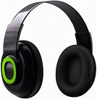
Library Books and Computer Lab
Our library day to be on Mondays. Please make sure to have students bring in their books on the previous Friday, so that we are prepared to return them on our library day.
Computer time will occur daily within the classroom. Students will be asked to respond to prompts or work on IReady. However, it would benefit your child to have their own headphones. They can keep these in their backpack, ready to use each day. Also, I have had students that prefer to bring in their own mouse, as they do not like to use the mousepad on their laptops.

Slide 7
Homework/
Assessment Binder
*One-inch binder with two folders (will be provided). Students may use their own personal binder and folders if they choose. This binder will travel back and forth from home to school each day. The folders inside will be labeled “Homework” and “Parent.” This will help students stay more organized with papers being sent home. The binders help to protect folders within backpacks.
*Assessment Envelope:
This envelope will contain assessments that have been graded by the teacher. Please keep assessments and return the envelope to be reused. If there is something not graded correctly, please send back with a note, and I will regrade.

Slide 8
*Assignments will receive percentages when graded.
*I might also use a check, check plus, and check minus.
*Please note that some assignments might be graded by students, as we review as a group. These will come home in student binders within the “Parent” folder. They will put a star to indicate that it was graded by student.
*Papers in the envelopes are primarily what I use for students’ grades, along with observations and notes.

Slide 9
Spelling
Spelling patterns will be reviewed in class each week. Students will work on a spelling activity each day in class. However, we will not be having weekly spelling tests. I will grade students’ spelling on their writing assignments and in class spelling assignments.

Slide 10
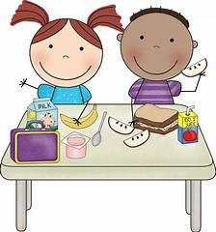
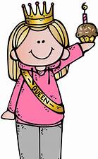
Federal laws require us to limit food items in class. We do not have birthday parties, because of various food allergies. However, I will give your child a pencil, a bookmark and/or a sticker. We will sing Happy Birthday to celebrate them on their day, and they will receive a Homework Pass.
*Non-food items/goodie bags are welcome! Please let me know ahead of time. I will pass them out at the end of the school day. Please do not take them to the office. Have your child bring goodie bags to the class.
*We will have seasonal parties and occasional classroom transformation activities that include food items. I will email parents of students with allergies to make accommodations or adjustments to my lessons based on the type of allergy. Please let me know of allergies on the student information form, and I will compile a class list.

Slide 11
Parent Volunteers:
Forms for parent volunteers are located on the stand-up table. I will have parent volunteers each Tuesday. Volunteers will be running multiplication checks. Due to the limited time constraint with our daily schedules, I will only have one day a week for volunteering. If you are interested in coming in on Tuesdays, you will be placed on a rotation. This often results in parents coming in 4-5 times throughout the year. We will also have special occasions where parents are welcome to come in and help. Volunteers will need to be cleared through the office. I do not start volunteers until the week after Labor Day. This will allow us to work on class routine before starting multiplication checks.

Slide 12
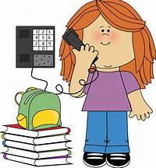
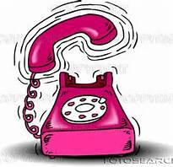
E-mail:
jhewitson@Murrieta.k12.ca.us
Phone: 951-969-1421 Ext. 2630
I have a middle schooler that I need to pick up after school. Email is the best way to contact me. I will, however, be available through appointments. This will allow me time to set up an alternate pick-up for my daughter.
The best way to contact me is through e-mail. Please allow at least 24 hours for a response. Although, most times I respond right away.
*Please note that I don’t always see the phone blinking, so phone messages may not be answered or seen right away.

Slide 13
Thank you for your time.

